Slide 1
Machine Learning with TensorFlow 2.0

Slide 2

Convolutional Neural Networks
5 Steps:
Convolution
Pooling
Flattening
Fully-connected
Softmax
towardsdatascience.com

Slide 3
Convolutions & Feature Maps
towardsdatascience.com

Slide 4
Pooling & Pooled Feature Maps
developers.google.com

Slide 5
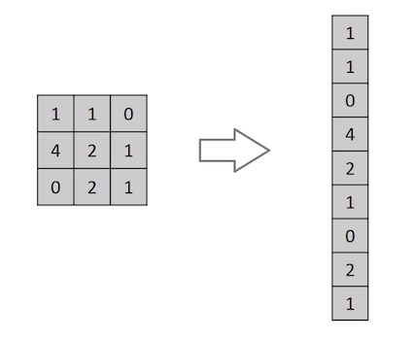
Flattening
towardsdatascience.com

Slide 6
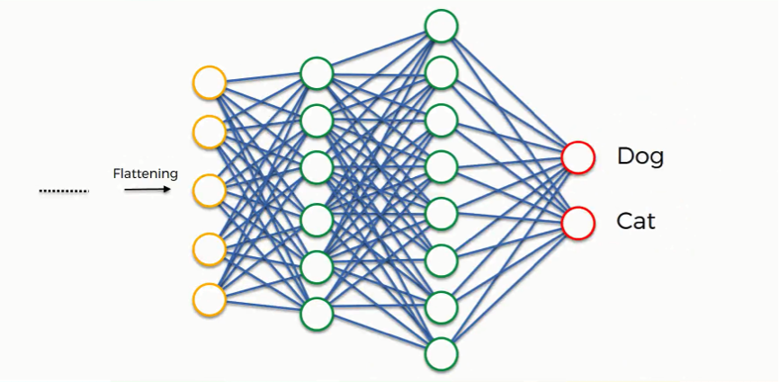
Fully-Connected / Dense Layer
superdatascience.com

Slide 7
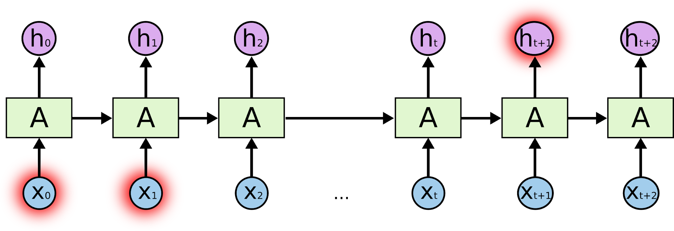

Long Short-Term Memory Networks
colah.github.io

Slide 8
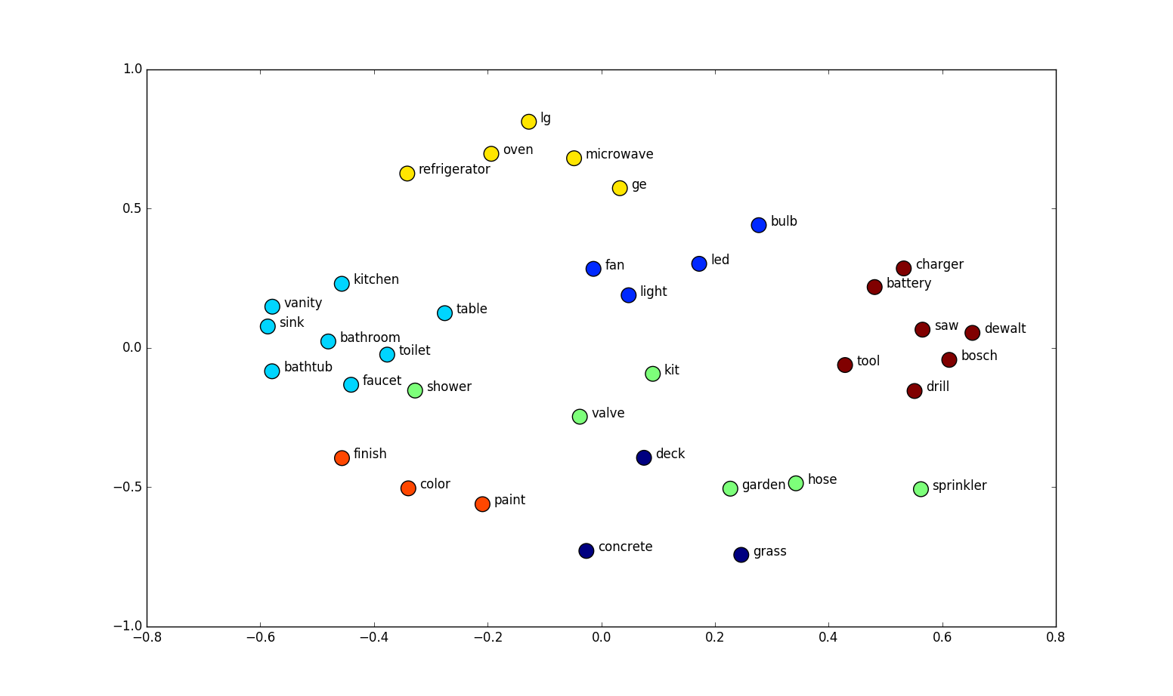
Word Embeddings - Tokenizing Text
shanelynn.ie

